Slide 1


R - Basics
Shah Ayub Quadri
Ayub.quadri89@gmail.com

Slide 2
Variables
Variables:
This are the placeholders which can hold some data, this data can be altered as & when required
Eg: x = 5;
_y = 10;
Rules for variables
Variables names should starts with letter or period, in the later period case it should not be followed by a digit.
Variable name can be a combination of letters, numbers and underscore.
Reserved word cannot be used for identifiers.

Slide 3
Data Types in R
There are 5 data types in R
Numeric: Decimal values are referred as Numeric in R
Eg: x = 1.78
Integer: it includes integer number
Eg: x =10
Complex: it consists of combination of real number part and imaginer part
Eg: x = 21+8i
Logical: this data type holds logical values such as TRUE or FALSE
Eg: x = c(TRUE, FALSE, FALSE, TRUE)
x = a < b
Character: this data type holds sequence of characters or string elements
Eg: x = ‘Welcome to R programming’

Slide 4
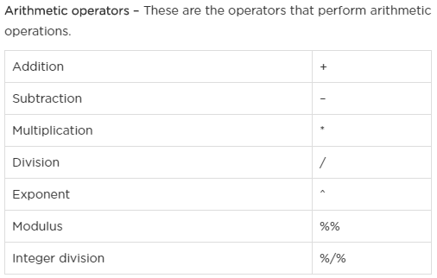
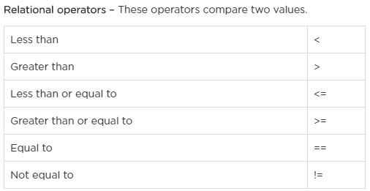
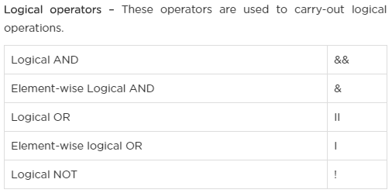
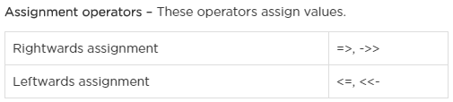
Operators in R

Slide 5
Data Structures in R
Data Structure defines the specific form of organizing & storing the data.
R has 6 types of data structures
Vectors: It contains the similar type of data
Eg: x = 1: 5, y = c(10,20,30,40,50);
Matrix: it’s a two-dimensional data structure consisting of rows and column.
Eg: x = matrix( 1:6, nrow =2, ncol = 3);
List: this data structure includes data of different types
Similar to vectors but vector contains similar type of data.
Eg: x = list(“a” = 2.5, “b” = True, “c” = 1:5)
str(x)
Data Frame: Special case of list where each component is of same length
Created using data.frame()
Eg: x = data.frame(“SN” = 1:2, “Age” = c(12,15), “Name” = c(“R” ,“Programming”) )
Factor: this are used to store categorical data
Eg: x = factor( “Software Engg”, “Data Scientist”, “Data Engg”, “Data Scientist”)
Strings: Any value written in single or double quotes are strings
Eg: x = ‘Welcome to R programming’; y = “New style of writing strings”;

Slide 6
Apply family in R
Apply:
When you want to apply a function to the rows or columns of a matrix
Returns a vector or array or list of values obtained by performing an operation to margins of an array or matrix
Margins of matrices 1 – Rows, 2 – column, 1:2 – Both
L apply:
When you want to apply a function to each element of a list
Returns a list which is of same size as that of input list(X) by applying a function or operation
S apply:
When you want to apply a function to each element of a list in turn, but you want a vector back, rather than a list.
M apply:
when you have several data structures (e.g. vectors, lists) and you want to apply a function to the 1st elements of each, and then the 2nd elements of each, etc.
Multiplicative version of sapply
It applies function to the first element of each argument, then second elements, then 3rd and so on.
T apply
when you want to apply a function to subsets of a vector
applies a function or operation on subset of the vector broken down by a given factor variable

Slide 7
Working with data in R
Import the data
Understanding the data variables-- what are their types
Split the data into test and train
Data type conversions
Descriptive stats for distribution of data and for outlier detection
Looking at the missing values --either removing or imputing them
Standardizing the data
a. Using Standardization
b. Using range
Converting the variables
From Categorical to numeric --Dummy
From Numeric to categorical -- Discretizing

Slide 8
References
Apply family functions
https://stackoverflow.com/questions/3505701/r-grouping-functions-sapply-vs-lapply-vs-apply-vs-tapply-vs-by-vs-aggrega
Introduction to R Course
https://www.datacamp.com/courses/free-introduction-to-r

